Slide 1
Vitality in a Virtual World

Slide 2
Working Online with Creativity

Slide 3
SELF CARE
Notes:
– Safety and self-care: Emphasis taking responsibility for what is shared. Working with metaphor is powerful work, which can connect us with deep emotions. [in the deep Emocean of our unconscious]. So, come alongside yourself to decide what feels OK for you to share, and to what extent. I’s good practice for us, as practitioners to experience ways of working that we may later take into our client work. Then we really understand what we are asking people to do, and how that might be for them.

Slide 5
Learning Contract
Experience with music, small group discussion
Theory pieces, small group discussion
Experience – My Creativity ID, small group discussion
Ending & further opportunities

Slide 6
Your Take-Away
We encourage you to take personal notes about your discoveries about you during the workshop!
We want to facilitate you building a picture of your “Creative Self”
as a take-away from this workshop!

Slide 7
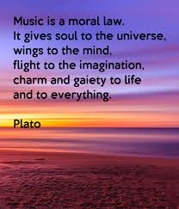

Slide 8
Notes:
Introduction to the wounded child and the wonder child (Tony Evans). How Metaphor can help to gain insight into how these aspects of self can influence.

Slide 9
The Spring of Creativity
“Creativity requires both originality and usefulness”
(Stein 1953)

Slide 10
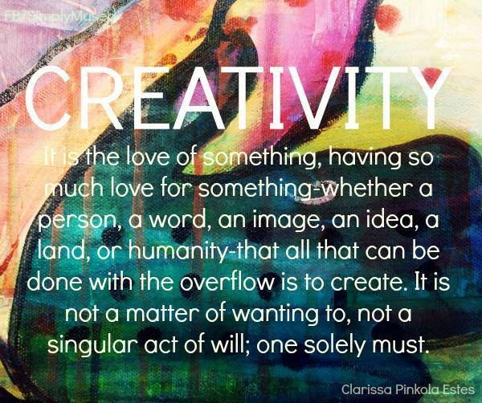

Slide 11
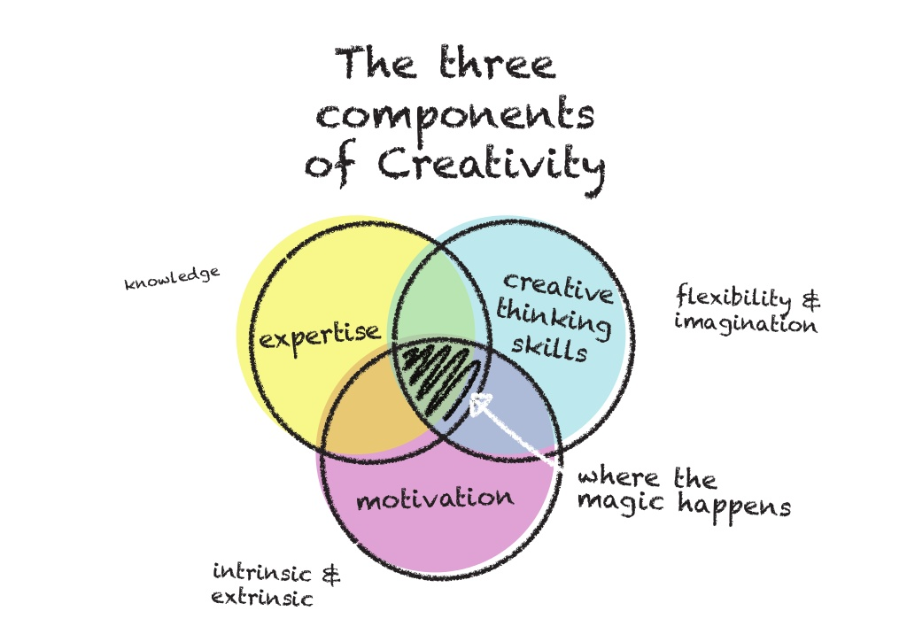

Slide 12
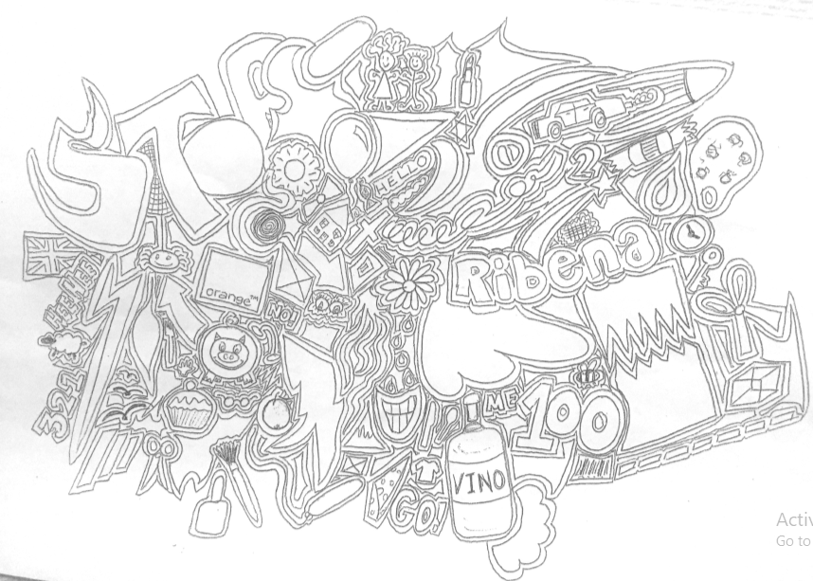

Slide 13
Doodle Picture
What can you see?
Select 3 images from the picture.
List them in order of preference.
What image(s) would you add to develop the picture ?
What colour would you paint your image(s)?

Slide 15
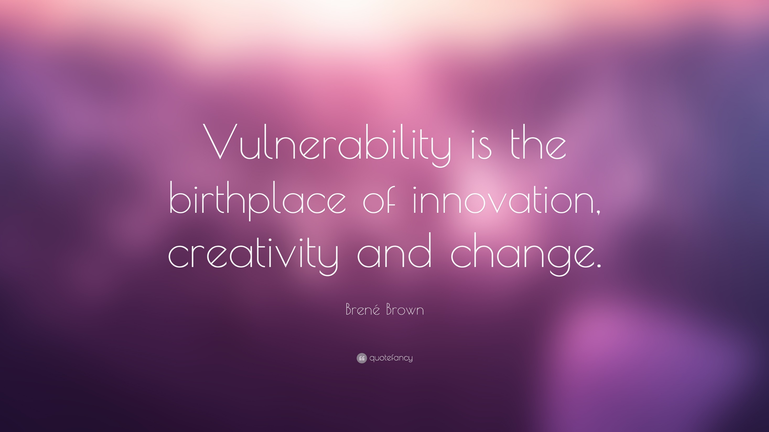

Slide 16
A definition of creativity by Carl Rogers
“A creative act is…..
The natural behaviour of an organism which has a tendency to arise when that organism is open to all of its inner and outer experiencing.”

Slide 17
What does that mean to us as professionals?
Being open to all my inner experiencing
Therapists – attentive to my soma, my body?
The inner experience of the relationship?
Being open to “counter-transference” – the “dance” within my chest.
Nurturing and rewarding my intuition.
Being open to all my outer experiencing
Alertness to constructivism – and hidden, archaic rules
“Because this is how we do it!” – why is it?
Allowing self to be impacted by other and the world.

Slide 18
Being open to the “inner” experience
Openness to experience: extensionality - the opposite of psychological defensiveness – a lack of rigidity; an openness to what exists at this moment.
Although the above refers to the inner experience, it could as easily refer to the outer.
Extensionality versus psychological defensiveness
“a therapeutic stance”

Slide 19
Being open to the “co-created” and “external” experience
An internal locus of evaluation
The value of the “product” is established by self –
(rather than by looking to the other)
This demands courage by the individual

Slide 21
“The Hunch” – Constructivism exposed – seeing behind the curtain.
“It is from this spontaneous toying and exploration that there arises the hunch, the creative seeing of life in a new and significant way.”
“Creativity is not, in my judgement, restricted to some particular content………
“It is the emergence in action of a more novel relational product, growing out of the uniqueness of the individual on the one hand, and the materials, events, people, or circumstances of his life on the other.”

Slide 22
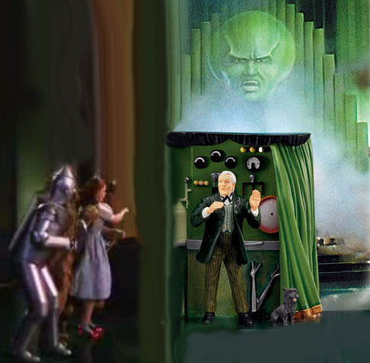

Slide 23
Reference – Carl Rogers
An essay be Carl Rogers:
Rogers, C. (1954). Toward a Theory of Creativity. ETC: A Review of General Semantics, 11, 249-260.
Available for free during the Covid crisis.

Slide 24
Creativity Summer School
3 x 3 hr workshops
6, 13 and 20 August.
Three workshops on the theory and practise of creativity.
Click here for more info

